Slide 1
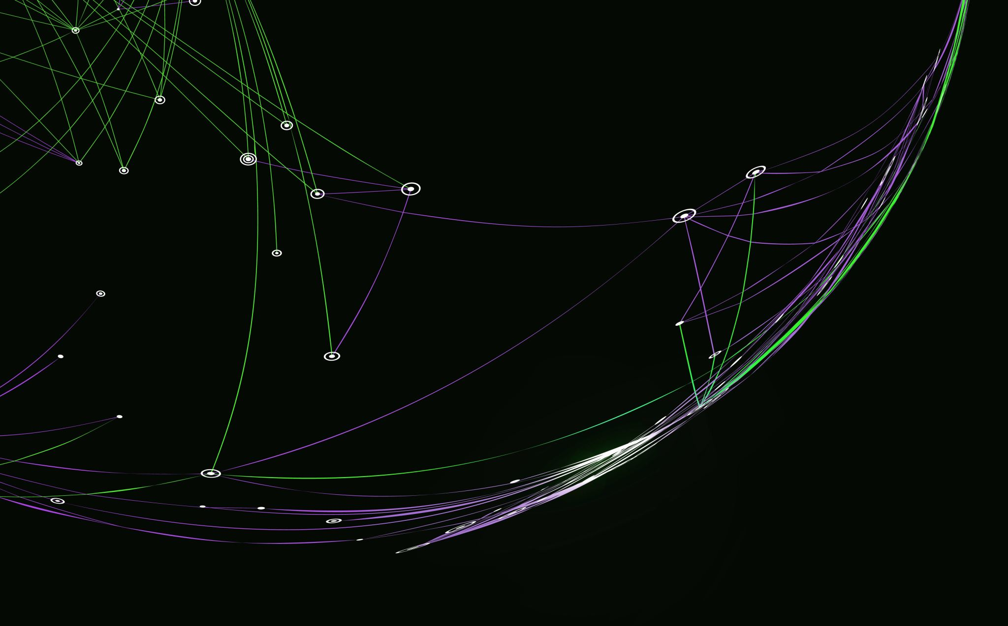
Group Midterm
-Whole class

Slide 2
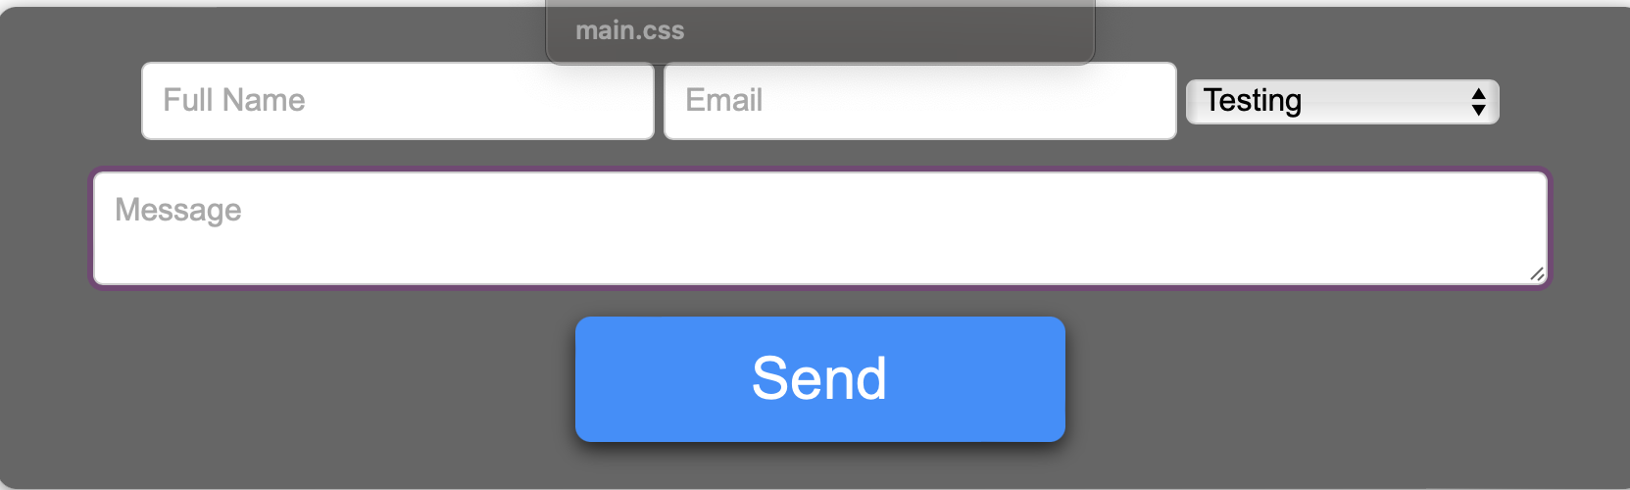
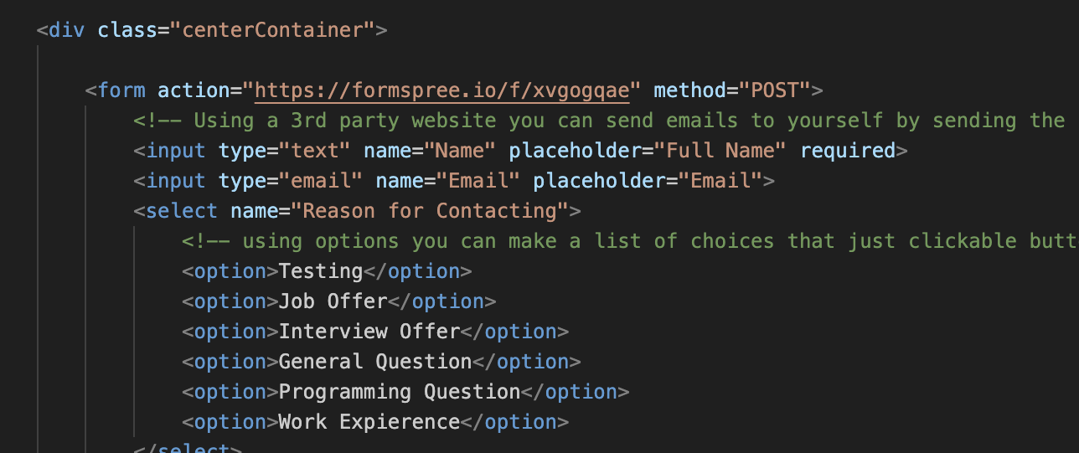
Html
What is showed here is the output and the code of a container for page6

Slide 3
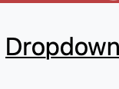
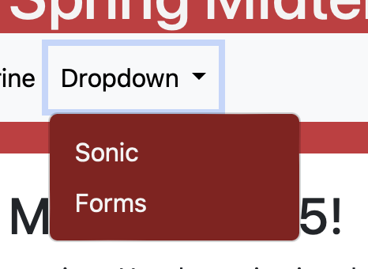
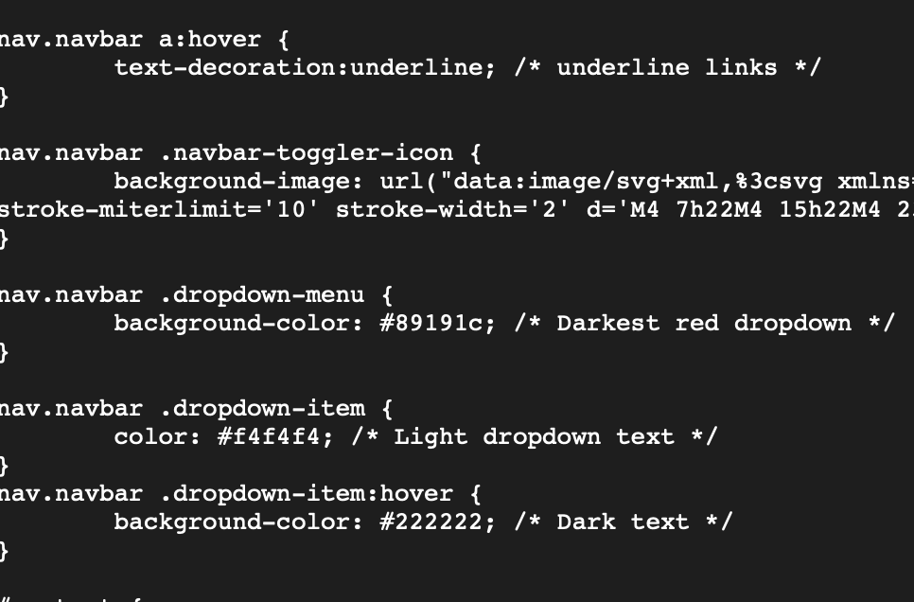
CSS
This is the code for the dropdown color and what happens when it is hovered over for page 1

Slide 4
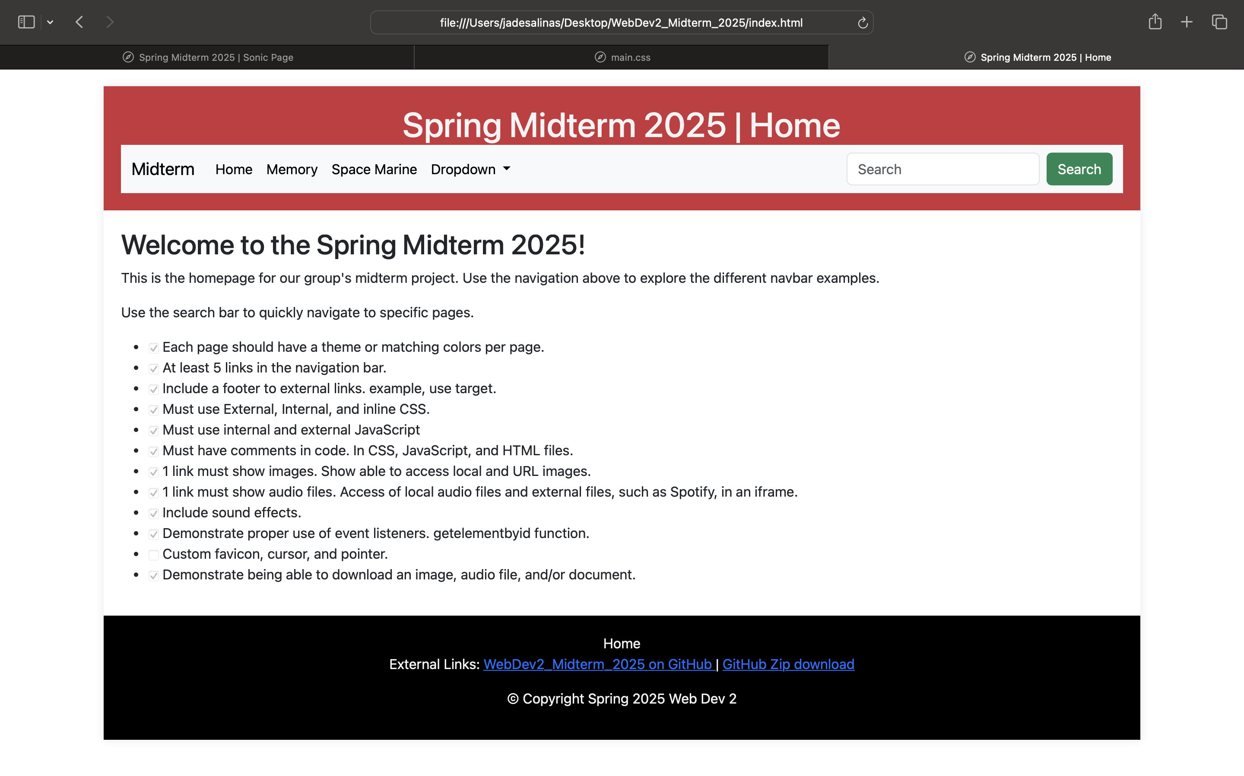
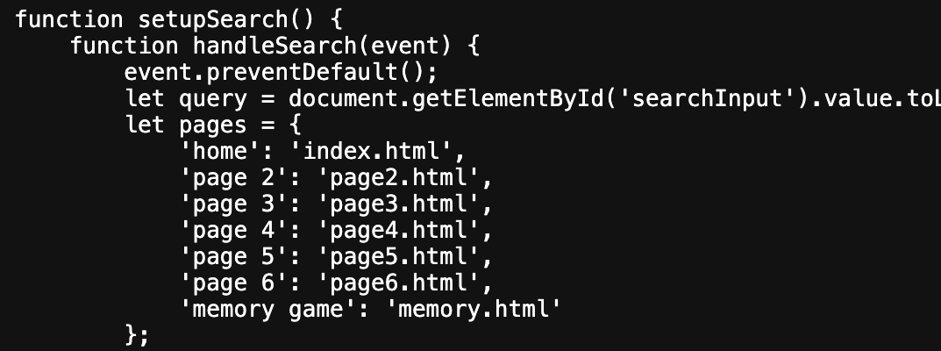
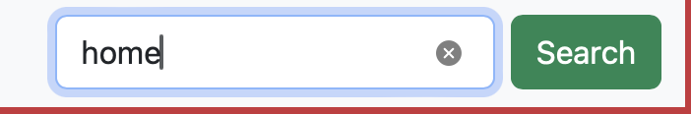
Javascript
This is shows the outcome when home is searched from down below and the side is what happens after. JS is the reason behind it

Slide 5
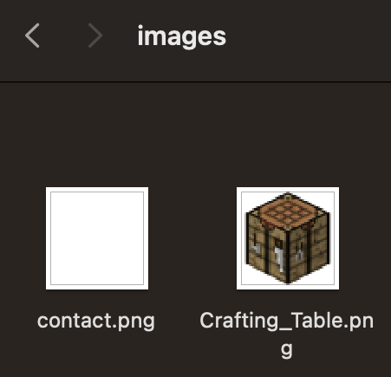
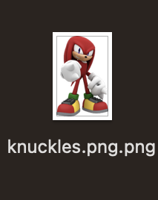
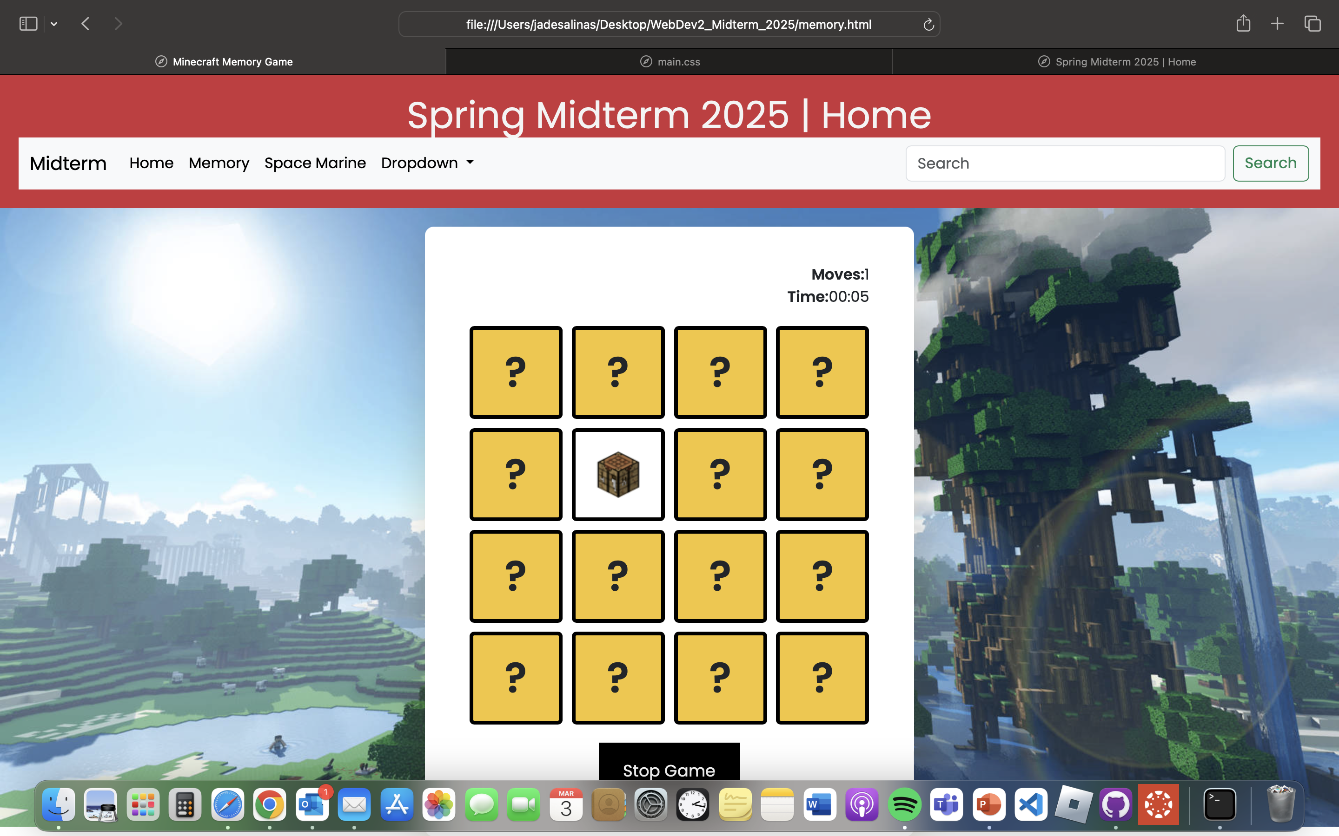
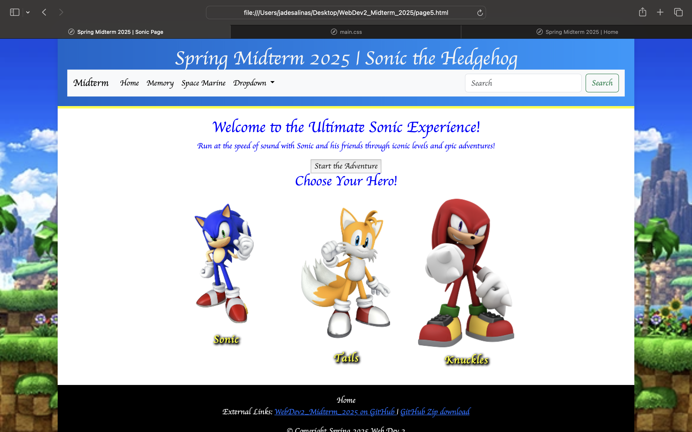
Images
Most images used were for the memory game along with some placed for certain pages

Slide 6
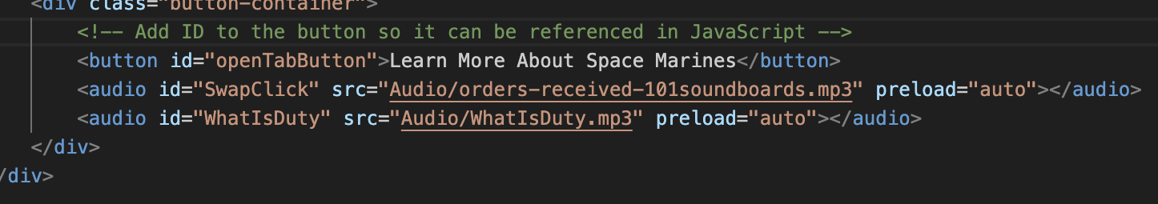
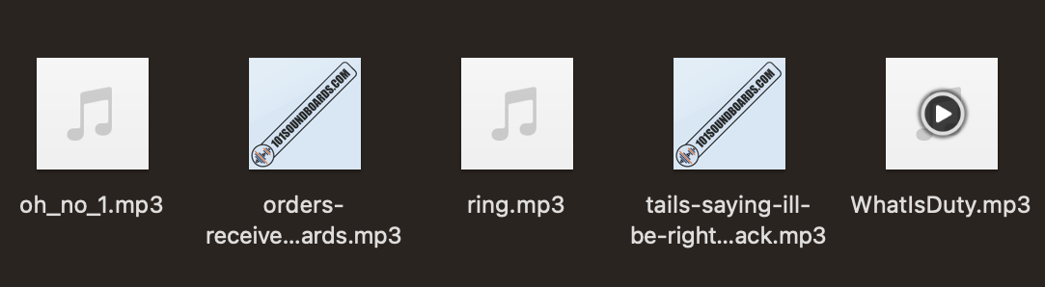
Audio
This is just a small piece of audio that was placed into page 3- orders-receive and whatIsDuty auidos

Slide 7
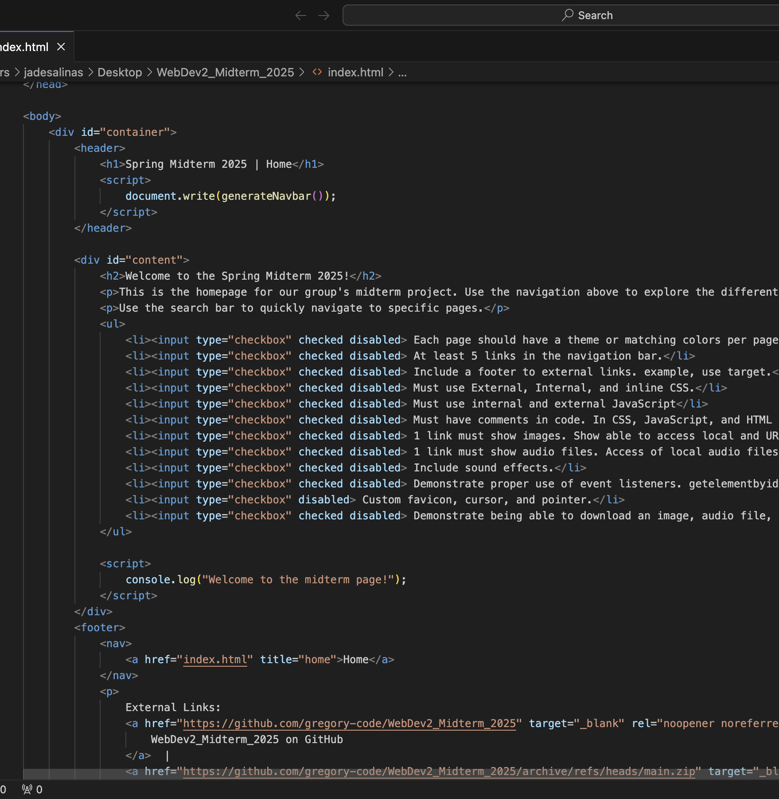
Errors/ Complications
D.C-He used AI/ChatGPT to edit and correct errors that presented itself and helped refine the whole thing to make it look more put together.

Slide 8
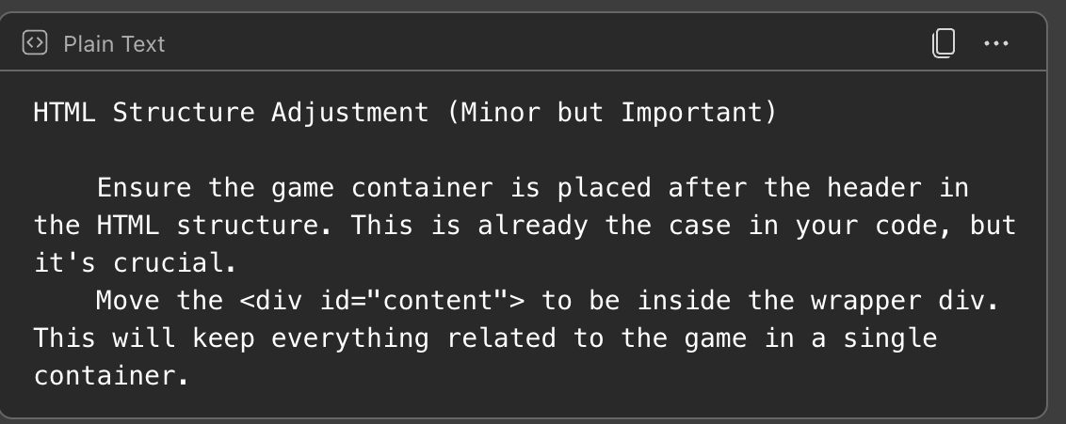
Any ChatGPT
To correct errors
To get rid of excess/useless code

